Slide 1
Freertos
Introduction

Slide 2

What is FreeRTOS?
A free, open-source real-time operating system (RTOS)
Developed by Richard Barry (Director, Real Time Engineers Ltd., UK)
15+ years old, currently at v10.4.0
Dual licensing
Free: FreeRTOS (MIT open source license)
Commercial:
OpenRTOS™ - Technical support
SAFERTOS™ - Domain certified derivative
FreeRTOS+ - Libraries for networks, file-systems, etc.
Meant for microcontrollers and small microprocessors
Features
Lucid, simple approach
Basic kernel is just 3 C files
Tiny, power-saving kernel
Some architectures feature a tick-less power saving mode
Supported on 40+ architectures
ARM, PIC, AVR, Marvell, MIPS, NXP, RISC-V, …
Full details: https://freertos.org/RTOS_ports.html
www.freertos.org

Slide 3
FreeRTOS: Functionalities
Designed from the ground up
To fit onto very small embedded systems
Implements
Simple API-based task management
Preemptive tasks
Support for priority
Unlimited number of tasks and priorities
Minimalistic memory handling (optional)
Bare-minimum API for synchronization
Queues, Semaphores, Mutexes
Tiny footprint
4.3Kbytes on ARM7
Written in C
Supports a variety of compilers (gcc, PIC C18 MPLAB, VC++, …)

Slide 4
FreeRTOS: Tasks – Task functions
Unlimited number of tasks can run
As long as hardware and memory can handle it
Support for cyclic (periodic) and acyclic tasks
API/signature for a task function:
void task_function(void *pvParameters);
Inside a task function:
void task_function(void *pvParameters)
{
int my_var; // local variable in task
for (;;)
{
// Task code implementation
}
return; // Ideally, should not reach this point
}

Slide 5
FreeRTOS: Task handling API - Create
portBASE_TYPE xTaskCreate(
TaskFunction_t pvTaskCode,
const char * const pcName,
configSTACK_DEPTH_TYPE usStackDepth,
void *pvParameters,
UBaseType_t uxPriority,
TaskHandle_t *pxCreatedTask
);
Argument | Remarks
pvTaskCode | Pointer to the task function
pcName | Human-readable string naming the task
usStackDepth | Depth of the task stack
pvParameters | Optional parameters sent to the task
uxPriority | Priority of the task
pxCreatedTask | Pointer to the created task (handle)

Slide 6
FreeRTOS: Task handling APIs
Delete a task
void vTaskDelete( TaskHandle_t xTask );
Get task priority
UBaseType_t uxTaskPriorityGet( TaskHandle_t xTask );
Set task priority
void vTaskPrioritySet( TaskHandle_t xTask, UBaseType_t uxNewPriority );
Suspend a task
void vTaskSupend( TaskHandle_t xTask );
Resume a suspended task
void vTaskResume( TaskHandle_t xTask );
Get a delay
void vTaskDelay( const TickType_t xTicksToDelay);
Get list of tasks in the system
void vTaskList( char *pcWriteBuffer );

Slide 7
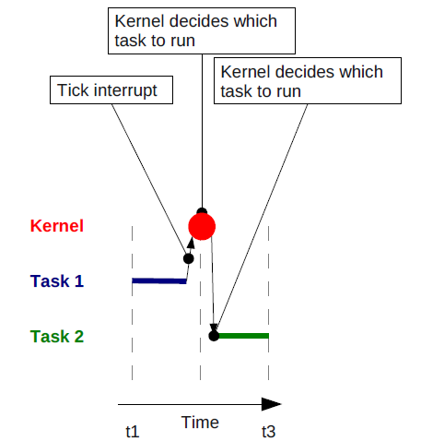
FreeRTOS: Scheduler internals
Concept of ‘tick’
Smallest time-slice the Scheduler is aware of
On every tick, Kernel gets a ‘tick’ interrupt
Scheduler
Decides which task to switch to
Consults Ready and Waiting task lists
Looks at task priorities
This is done in the Tick interrupt ISR
Needs to be extremely fast

Slide 8
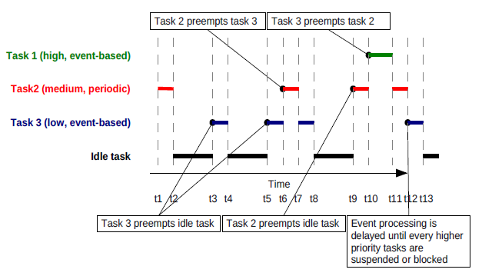
FreeRTOS: Scheduler in action
Scheduler
Juggles between switching various tasks
Different priorities, rates (periods), events, etc.
Runs an ‘idle’ task
When nothing else needs to run

Slide 9
FreeRTOS: Code structure
ISRs, Task code
Main code
void interrupt HandleInterupt ()
{
// ISR code
}
void Task1(void *Task1_Params)
{
while(1)
{
// Task1 code
}
}
void TaskN(void *TaskN_Params)
{
while (1)
{
// TaskN code
}
}
void main(void)
{
System_Init();
// Task1
xTaskCreate(…);
…
// Task N
xTaskCreate(…);
vTaskStartScheduler();
return;
}

Slide 10
Advantages of using a real-time kernel
A real-time kernel (like FreeRTOS):
Abstracts away timing information and consideration
Eases maintainability and extensibility of modules
Increases code modularity
Enhances collaborative (team) development
Enables better code re-use
Improves system and resource usage efficiency
Enables tracing and background checks (as part of idle time)
Betters power management (derived from efficiency boost)
Makes interrupt handling flexible
Addresses mixed processing requirements

Slide 11
FreeRTOS summary
What is FreeRTOS?
Licensing options
Applicability to embedded system product development
Elementary look at
Task handling APIs
Kernel (scheduler) internals
Material is based on:
Nicolas Melot’s “Study of an Operating System: FreeRTOS”
Link:
http://wiki.csie.ncku.edu.tw/embedded/FreeRTOS_Melot.pdf

Slide 12
Thank you!

